Slide 1

Open Ended Lab Project:
Study of Quantized Gradient Descent & Bit Allocation Effects on Convergence
(Static vs Dynamic)
Jeeva Jayaprakash - 142301012 Akshat Nair - 142301038

Slide 2
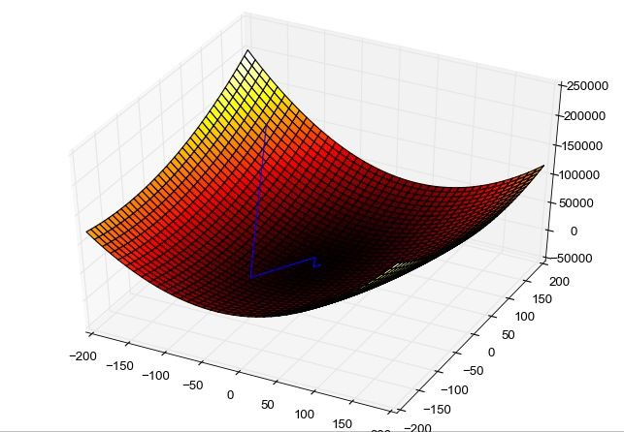
Introduction
What is QGD?
Quantized Gradient Descent (QGD) is a variant of gradient descent optimization algorithm that uses reduced precision representations of gradients and model parameters during training.
What is our Objective?
Analyze the impact of quantization and bit allocation on the convergence behavior of optimization algorithms, specifically focusing on how different bit distributions inﬂuence the trade-off between precision, memory efficiency, and overall convergence speed in high-dimensional functions.

Slide 3
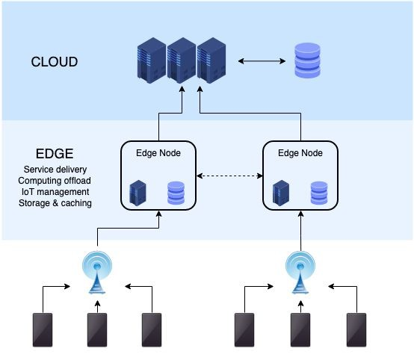
Applications:
Quantized Gradient Descent (QGD) has numerous practical applications in modern machine learning and distributed systems. Here are the key applications and their implementations:
Edge Computing Applications
IoT Device Training
Enables machine learning on resource-constrained devices
Reduces communication overhead between edge devices
Maintains model accuracy while minimizing bandwidth usage
Real-time Processing
Facilitates quick model updates on edge devices
Supports low-latency applications
Enables efficient distributed inference
Distributed Learning Systems
Federated Learning
Enables privacy-preserving model training
Reduces communication costs between clients and server
Maintains model accuracy despite quantization
Large-Scale Optimization
Efficiently handles massive datasets
Supports parallel processing across multiple nodes
Maintains convergence guarantees despite quantization noise

Slide 4
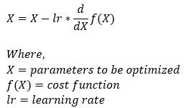
Mathematical Background of Gradient Descent
NOTE: When dealing with multiple attributes we simply put X as a column matrix of the same attributes, and instead of d/dX we use the del operator on f(x).

Slide 5
Introduction
What is QGD?
Quantized Gradient Descent (QGD) is a variant of gradient descent optimization algorithm that uses reduced precision representations of gradients and model parameters during training.
What is our Objective?
Analyze the impact of quantization and bit allocation on the convergence behavior of optimization algorithms, specifically focusing on how different bit distributions inﬂuence the trade-off between precision, memory efficiency, and overall convergence speed in high-dimensional functions.

Slide 6
Applications:
Quantized Gradient Descent (QGD) has numerous practical applications in modern machine learning and distributed systems. Here are the key applications and their implementations:
Edge Computing Applications
IoT Device Training
Enables machine learning on resource-constrained devices
Reduces communication overhead between edge devices
Maintains model accuracy while minimizing bandwidth usage
Real-time Processing
Facilitates quick model updates on edge devices
Supports low-latency applications
Enables efficient distributed inference
Distributed Learning Systems
Federated Learning
Enables privacy-preserving model training
Reduces communication costs between clients and server
Maintains model accuracy despite quantization
Large-Scale Optimization
Efficiently handles massive datasets
Supports parallel processing across multiple nodes
Maintains convergence guarantees despite quantization noise

Slide 7
Mathematical Background of Gradient Descent
NOTE: When dealing with multiple attributes we simply put X as a column matrix of the same attributes, and instead of d/dX we use the del operator on f(x).

Slide 8
Problem Statement and Challenges
How does the bit allocation strategy affect the convergence rate of Quantized Gradient Descent in distributed optimization scenarios? Further questions to look into:
What is the optimal distribution of bits across gradient components?
How does dynamic vs static bit allocation inﬂuence optimization speed?
Can we reach a point where we have both low cost communication and high accuracy?
In our project we shall be looking at these scenarios and compare them to finally come up with optimized strategies that manage this problem efficiently.
Apart from how we allocate bits to attributes, we come across one specific challenge (which we have to keep in mind while trying different bit distributions) :
Accuracy Trade-offs
Higher precision reduces noise but increases communication cost.
Lower precision increases noise but improves efficiency.
Thus Finding optimal balance is critical.

Slide 9

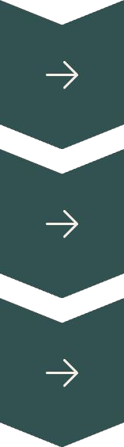
Bit Allocation Strategies
Uniform
Equal bits for all parameters.
Non-uniform
Varying bits based on parameter importance.
Adaptive
Dynamically adjusting bit allocation.

Slide 10
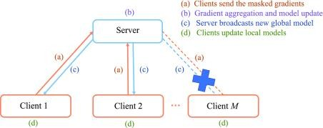
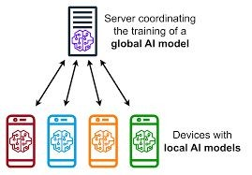
Setup description
Here is a visual representation of the setup we are going to use for the project.
It involves a server that can update X, clients who locally update X and compute gradients of f(X) and send them to the server with a fixed bit budget (thus needing to quantize).
This is the step that causes a loss in precision but improves communication cost.

Slide 11
Implementation in Python
For our test case we have primarily used python to emulate a controlled bit allocation setting for each attribute. Currently we are going to give our own fixed bit distributions - could be uniform or non uniform.
For plotting graphs and comparing strategies, we made use of matplotlib.
There is no separate code for server and client, they’re both in the same code.

Slide 12

Simulation setup
We shall simulate a dataset to test logistic regression, starting by assuming we know the true weights (a vector of size 10 with values between -2 and 2).
These true weights represent the ideal solution we will later try to recover.
Generating Data:
We generate 100,000 random input vectors X, each of size 10, with values between -5 and 5.
For each X, we compute the dot product with the true weights to get a raw score.
Then apply the sigmoid function to this score to get a probability p:

Slide 13
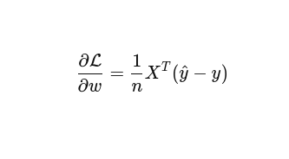
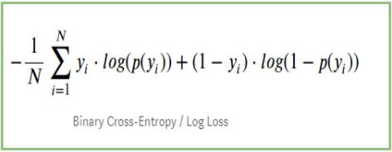
We have obtained y labels (probabilities), so our next step is to add noise to our X vectors and the corresponding y labels.
Finally:
We discard the true weights and only keep the generated X and y (with added noise).
Our task becomes:
"Given only the input vectors X and the labels y, can I use logistic regression to recover a good approximation of the original weights?"
This mirrors a real-world binary classification problem, where we try to learn parameters that model the relationship between features and labels.
Since we do know the true weights, at the end it is easier to determine how accurate our model is.
Log Loss function
Gradient of Log Loss

Slide 14
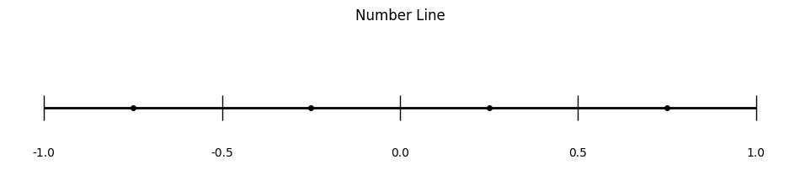
Some insight into our encoding logic
Say for a certain component, the allowed number of bits is 2. That means we have 2^2 = 4 encodings available. This corresponds to 4 regions that we can section the range of [-1,1] into. The regions will have encodings 00, 01, 10, 11 (left to right). Each encoding is actually mapped to a value which is the mean of the 2 numbers that mark its region.
For an example let’s say a component’s value is 0.8213. This will get mapped to the region between 0.5 and 1, with encoding ‘11’. When it gets decoded it’ll be equal to 0.75 (mean of 0.5 and 1).

Slide 15
Stopping/Converging criteria of the model
When do we stop performing more iterations of logistic regression?
We need a point where we can say that the values have converged or very near to converging. At that point we can stop running our model.
Here are the indicators we factored -
Difference between the change in gradient (threshold is “< 10^-9”)
Difference between log loss over multiple iterations (threshold “<10^-3 for at least 50 consecutive iterations”)
In case the previous 2 are never met, we ourselves set an upper limit to 5000 iterations

Slide 16
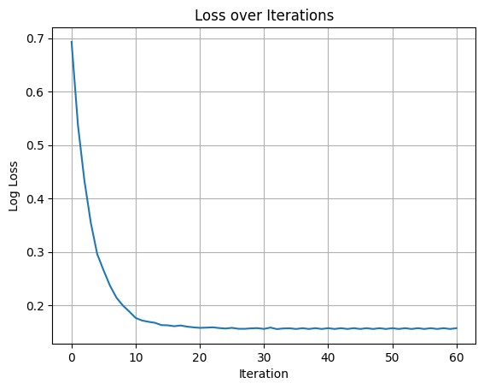
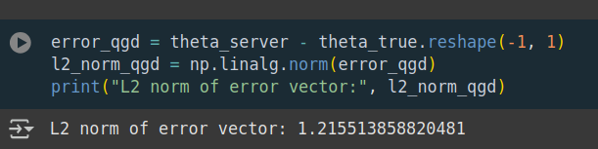
How does bit allocation affect The Gradient descent in our scenario:
OBSERVATION -
When we used 2 bits per attribute, we really needed to lower the threshold to get it to stop oscillating between values. Since it kept oscillating (due to low precision, thus jumping beyond the true value always), it wouldn’t trigger our set thresholds.
2 ( or 3) - bits per attribute

Slide 17
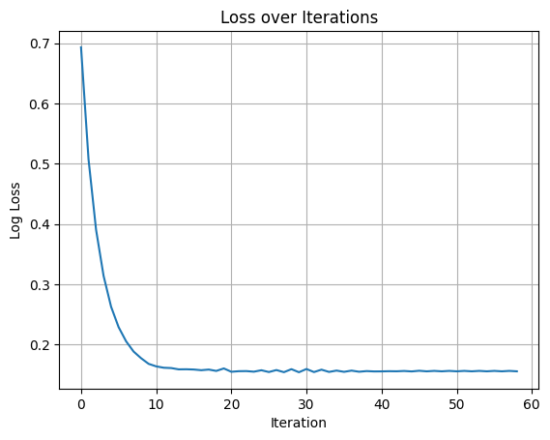
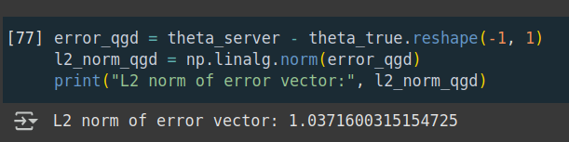
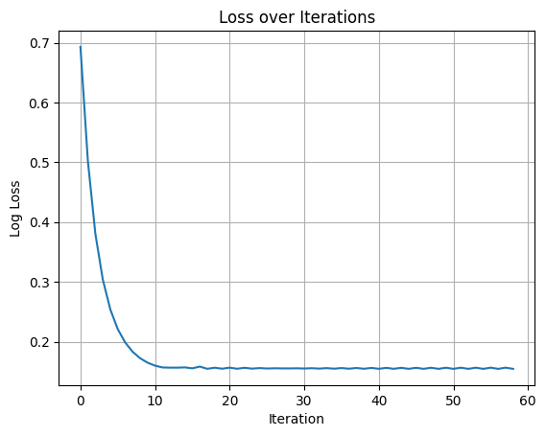
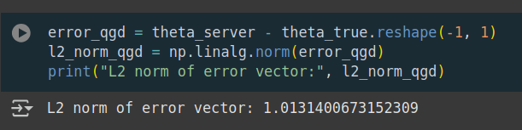
FOR 4 BITS PER ATTRIBUTE
INFERENCE :
Using 4 bits it took about 60 iterations to converge and the error in getting the true weights is lower than the previous case.
When we used 10 per attribute it is even more accurate as error is even lesser.
FOR 10 BITS PER ATTRIBUTE

Slide 18
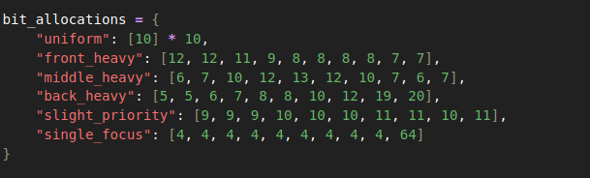
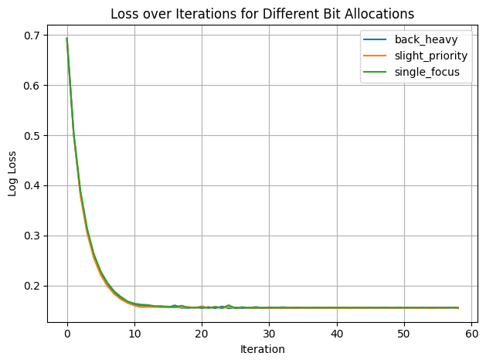
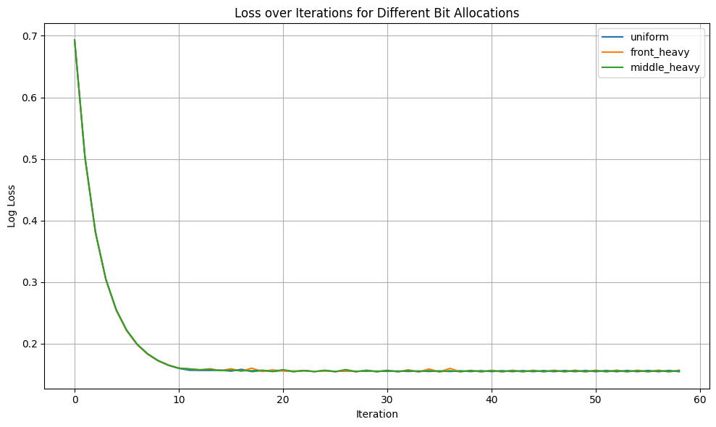
The Different Bit Allocations we used:
The Losses plotted using our training function for all these bit allocations:

Slide 19
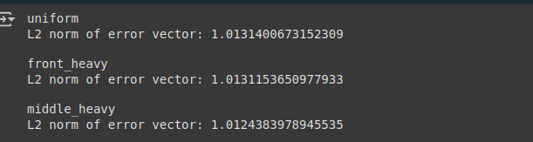
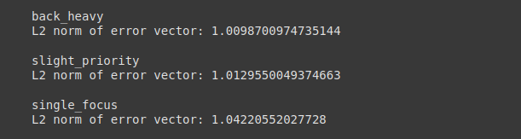
One measure of how good a certain bit allocation is to see how quickly it converges (number of iterations).
Based on that we can see all of our allocations take around equal number of iterations.
The other measure is to simply see the error in the final calculated theta using all our allocations.

Slide 20
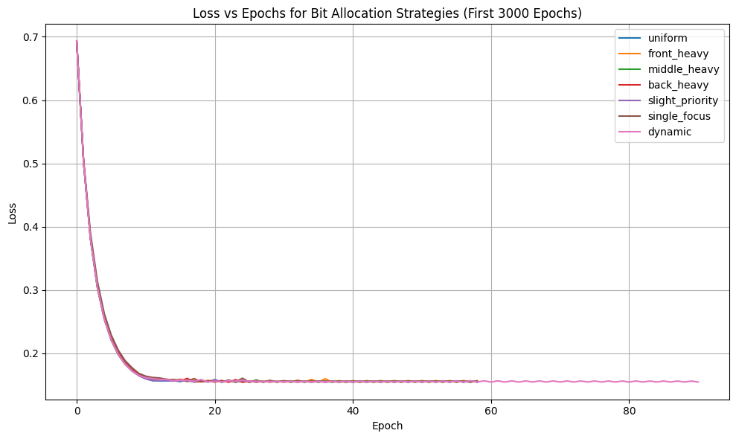
Dynamic bit allocation vs Static bit allocation
The idea of dynamic bit allocation is to change the bit distribution based on an importance measure. The importance measure we came up with is -
(difference in change of gradient) / (current change of gradient).
Then we normalize this quantity so that we can use it as a proportion to allocate bits.
Here is a comparison between the previously used static allocations and the dynamic allocation:

Slide 21
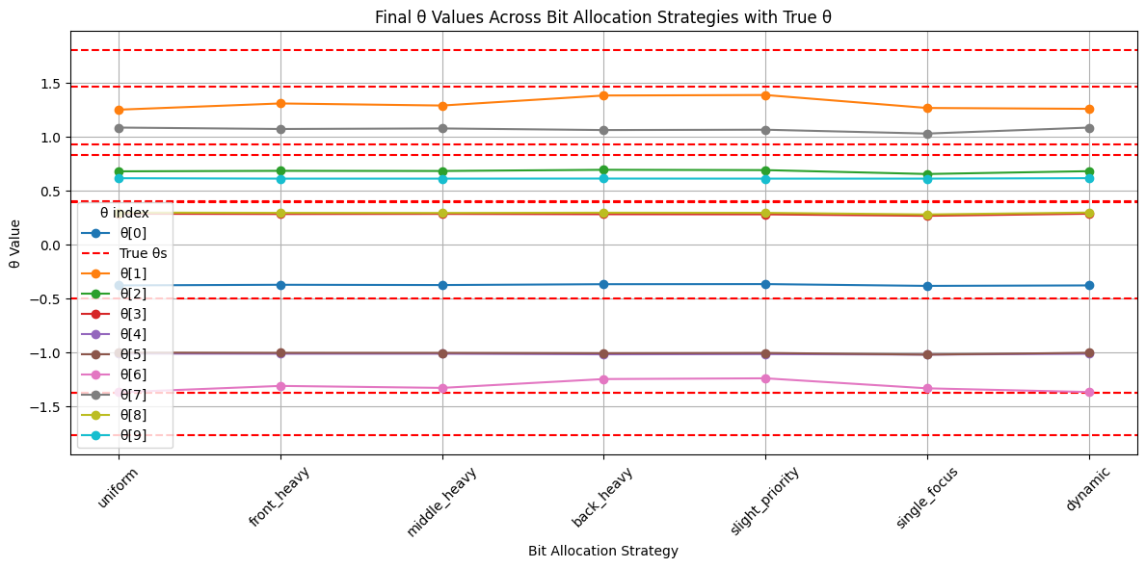
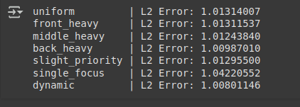
Final accuracy of weights
Here is a graph to highlight how close we got to the true weights using each kind of bit allocation strategy:

Slide 22
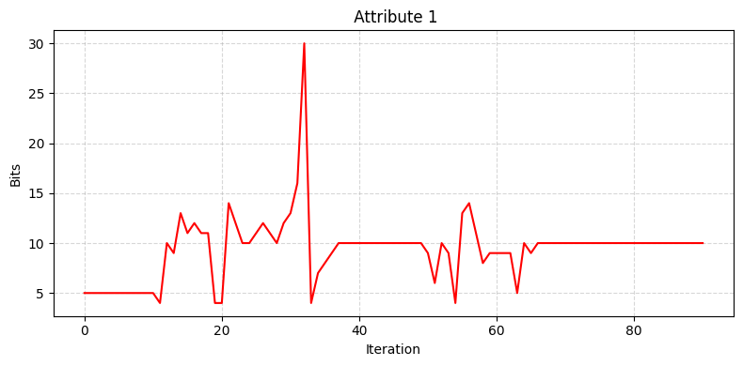
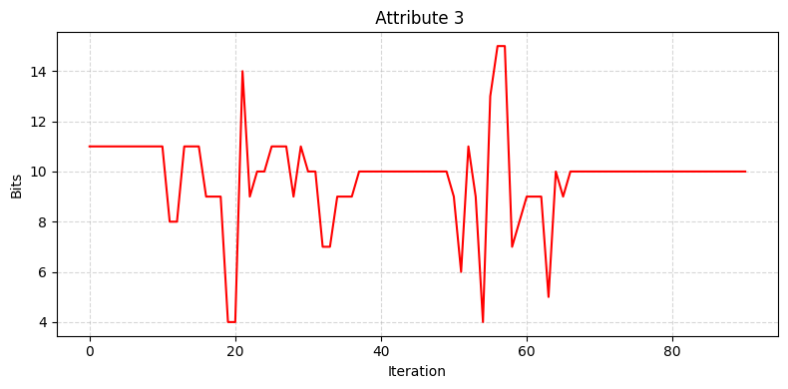
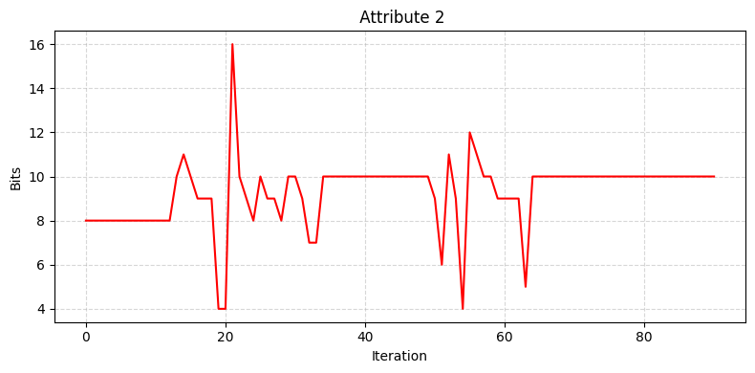
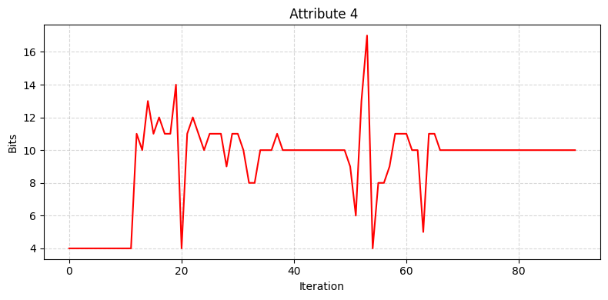
Inference from our experiments

Slide 23
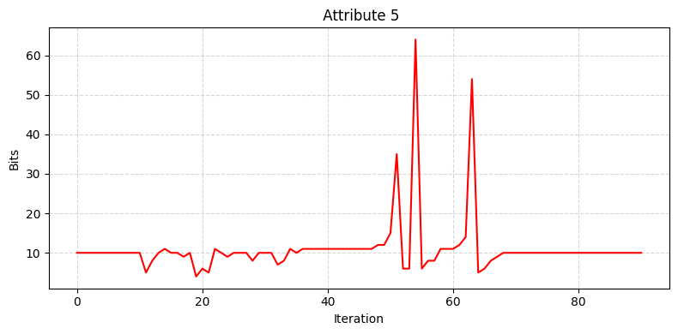
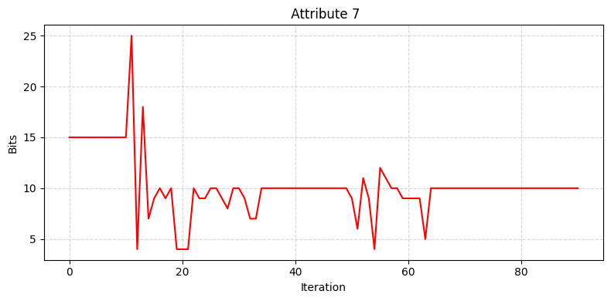
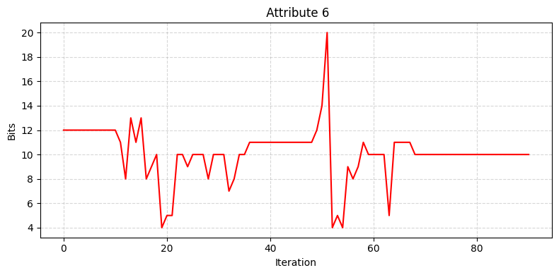
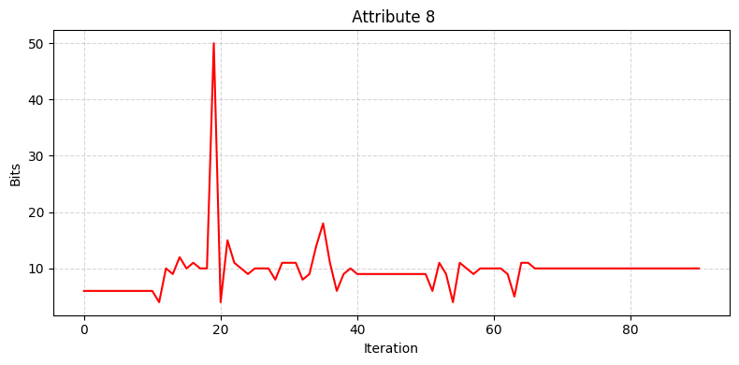
Inference from our experiments

Slide 24
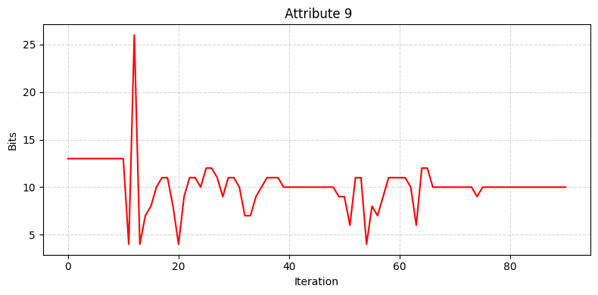
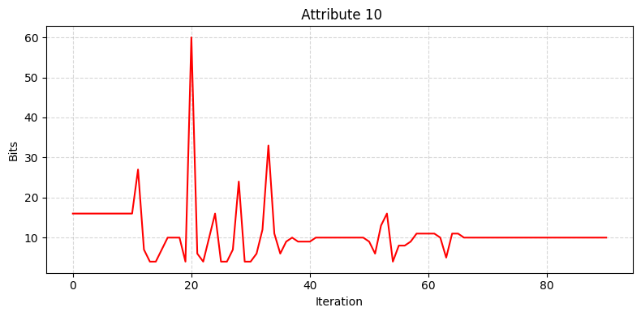
Inference from our experiments
An interesting thing to note is that we can see that the bit allocation for each attribute all converge to 10 which is uniform bit allocation as they near convergence.
From this we can infer that even if we start with a random bit allocation, our current setup and importance measure always lets our bit allocation tend to a uniform one. Thus uniform allocation is preferred by the dynamic allocation method as well.

Slide 25
Future objectives and add-ons
Adding elias coding to try various other scenarios and setups. This is an incomplete study of Quantized gradient descent and Bit allocation effects on convergence.

Slide 26
Bibliography:
https://www.google.com/url?sa=t&source=web&rct=j&opi=89978449&url=https
://arxiv.org/abs/1908.08200&ved=2ahUKEwiz2aX_5YmMAxU8UGcHHWLBGOI QFnoECBoQAQ&usg=AOvVaw3Ka3fgQKz22LjhHoKjDGYX
https://www.google.com/url?sa=t&source=web&rct=j&opi=89978449&url=https
://arxiv.org/abs/2302.05397&ved=2ahUKEwjrq5Pe5omMAxVdR2wGHVBmB1s QFnoECAkQAQ&usg=AOvVaw21u74G-5WLp16Y2Y6-uMgi
The above links are to research papers on similar problem statements.
https://colab.research.google.com/drive/1NeHtSPAEilI_Ri_1uhQaZ7Gskt47AZD4
?usp=sharing
The main content of our code till date is in the above collab file.
https://github.com/Stormbl3ss3d/QGD_OELP
Link to a public repository where the relevant code will be uploaded.

